Slide 1
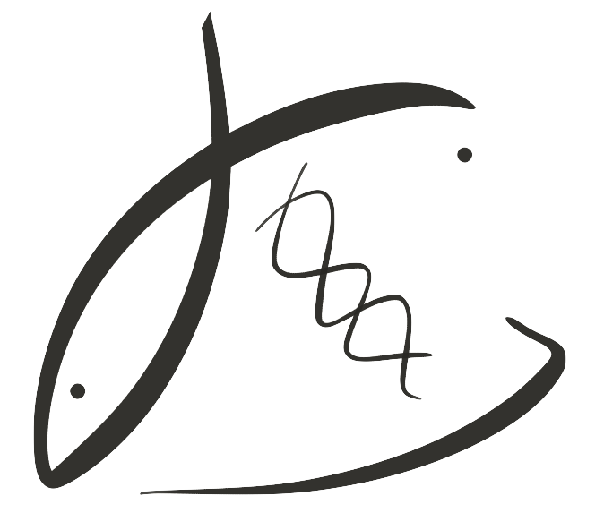





Carry-over effects of parental pH exposure in the Olympia oyster
Laura H Spencer
Roberts Lab
School of Aquatic and Fishery Sciences
University of Washington
Graduate Student Symposium 2018

Slide 2
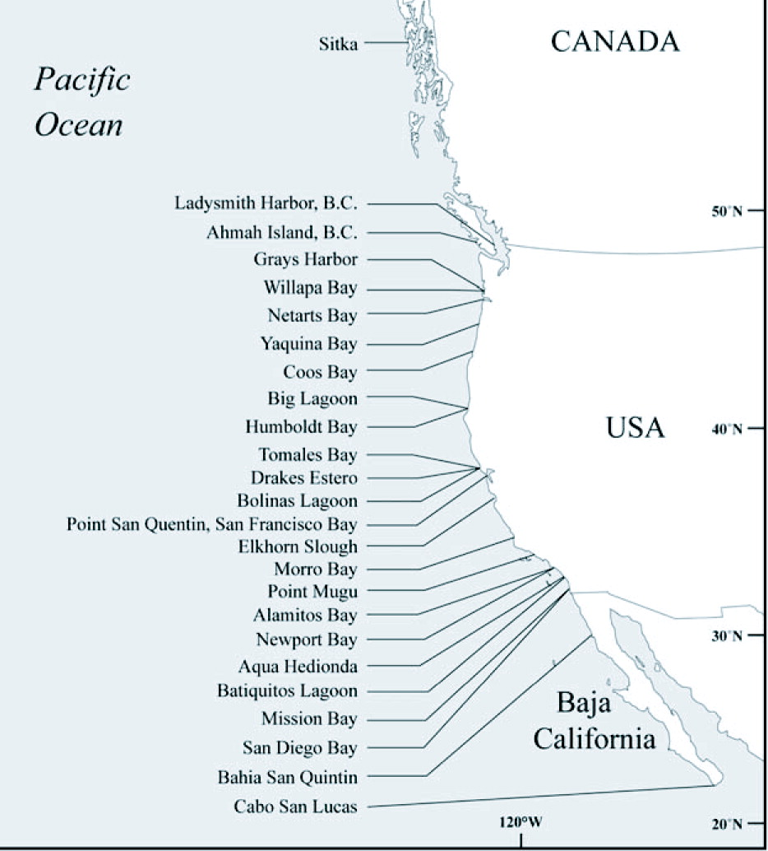
The Olympia oyster
Pacific Coast’s only native oyster
Populations are ~2% historic
Overharvest
Habitat loss …
Restoration investments along the coast
New threat:
ocean acidification
All Absent
Intertidal Absent
Present
Adapted from Polson & Zacherl, 2009
Notes:
MAP: Augmented map of 2009 Olympia oyster survey that found some locations Olys are absent entirely or absent in the intertidal.

Slide 3
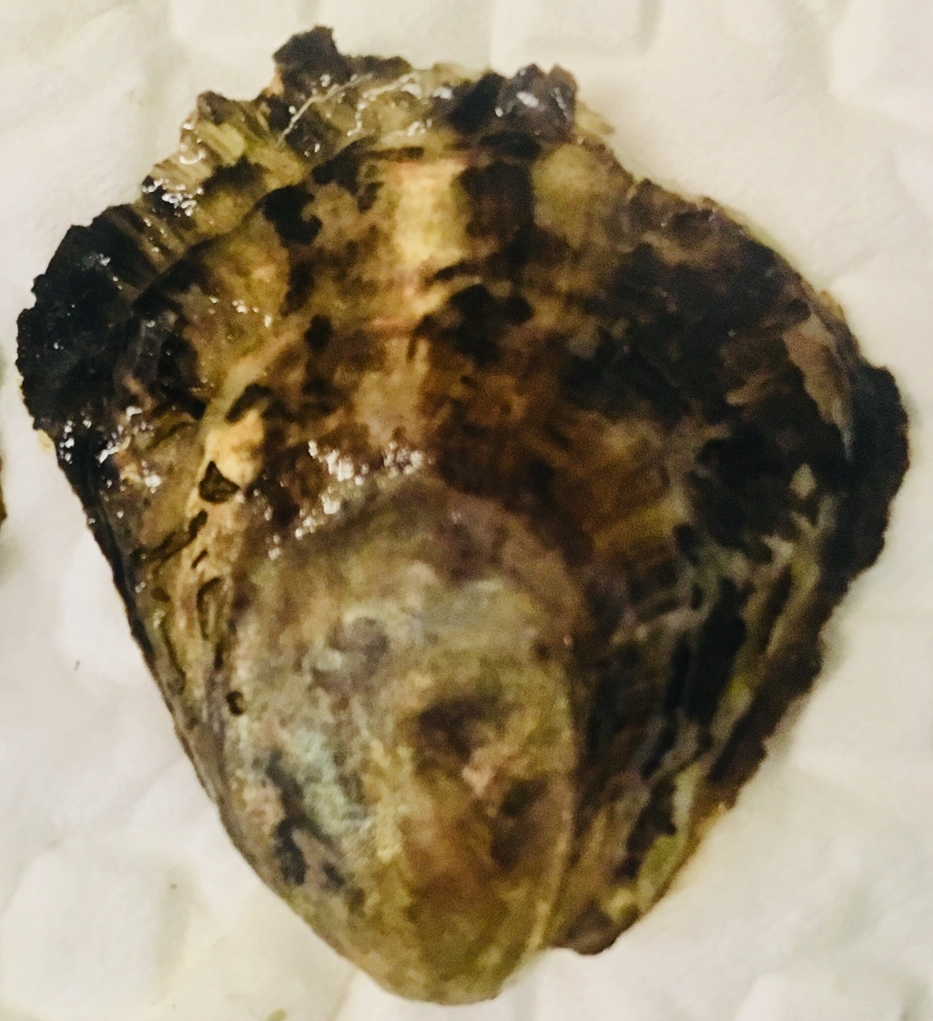
Ocean acidification, what we know
Early life stages are vulnerable
⬇ Larval growth, survival (Hettinger et al. 2013)
⬇ Juvenile growth after larval exposure (Hettinger et al. 2012)
⬆ Juvenile predation rate (Sanford et al. 2013)
Also evidence of tolerance (Waldbusser 2016)
Parental exposure?

Slide 4
Can oysters “adapt” to OA?
Parental exposure can influence offspring response to stress (e.g. Parker et al. 2012)
This may allow oyster populations or breeding lines to quickly respond to changing ocean
Notes:
Reason why we’re interested in exploring adult exposure is that there is an exciting and optimistic theory that a parent’s exposure to stress can make the next generation more resilient to that stress.
This may allow for oysters to respond more quickly to ocean acidification, rather than relying solely on classic adaptation through gene mutation and natural selection.
(Paper: putnam 2016? Jeremias 2018? Rondon 2017?

Slide 5
Parental exposure, other oysters
Negative carry-over:
⬇ larval survival, maternal Pacific oyster (Venkataraman in press)
⬇ fecundity, sex ratio change, Sydney rock oyster (Parker 2018)
Positive carry-over:
⬆ growth, Sydney rock oyster larvae (Parker 2012, 2015, 2017)
Olympia oyster?
Notes:
Parker 2012:
Parents exposed during reproductive conditioning
Larvae from exposed parents larger, grew faster
Larvae exposed to low pH did OK if parent was exposed. BUT, if exposed to a secondary stressor, not OK

Slide 6
Questions
How does adult low pH exposure affect:
Reproduction - gonad stage, # larvae produced
Offspring viability – survival, growth
Offspring response to pH – juvenile survival under stress, in varying pH

Slide 7
Design
Time
Phase
pH
Metric
Adults in pH treatment
(7 weeks)
Low (7.3) Ambient (7.8)
Gonad stage
Adults spawn, larvae collected
(7 weeks)
Ambient
pH
# larvae produced
Larvae reared
(to post-set)
Survival
Juveniles grown
(10 months)
Growth
Juveniles in pH treatment
(3 months)
Low (7.5) Ambient (7.8)
Survival
Notes:
2 adult cohorts

Slide 8
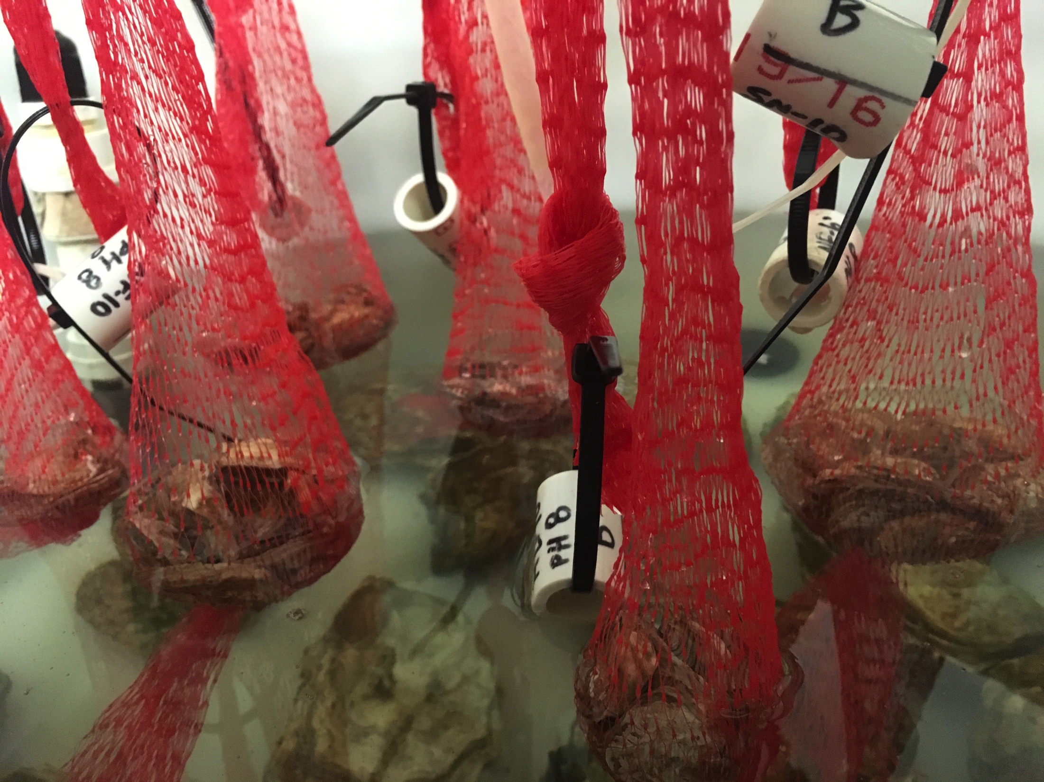
Adults held 7 weeks in low pH (7.3), ambient pH (7.8), at 10°C
pH
Spawn & collect
Rear
Grow
pH

Slide 9
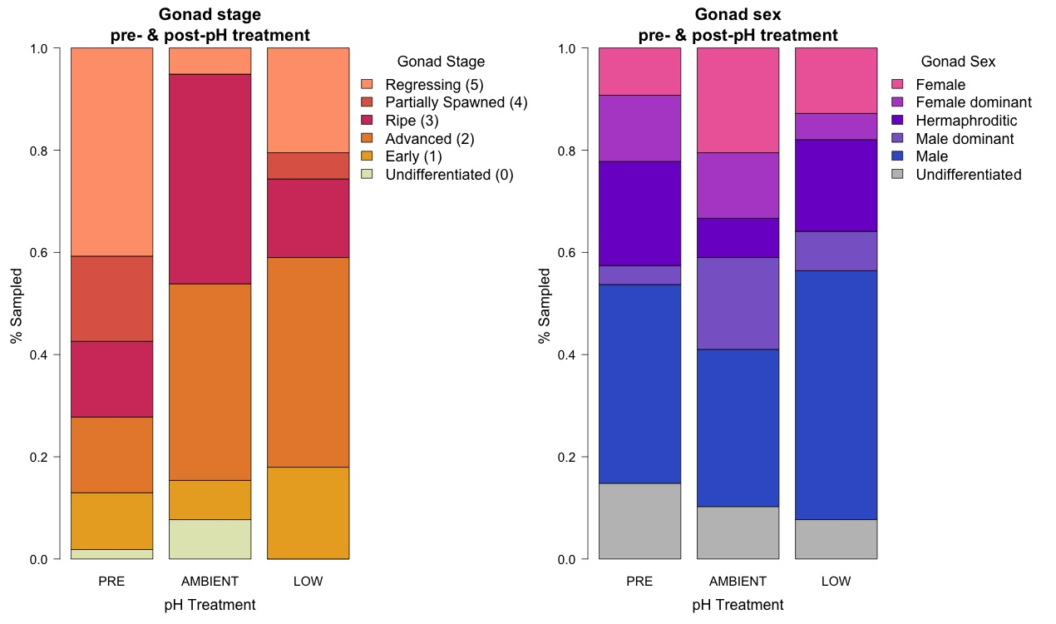
Gonad less developed in low pH
pH
Spawn & collect
Rear
Grow
p=0.0083
pH

Slide 10
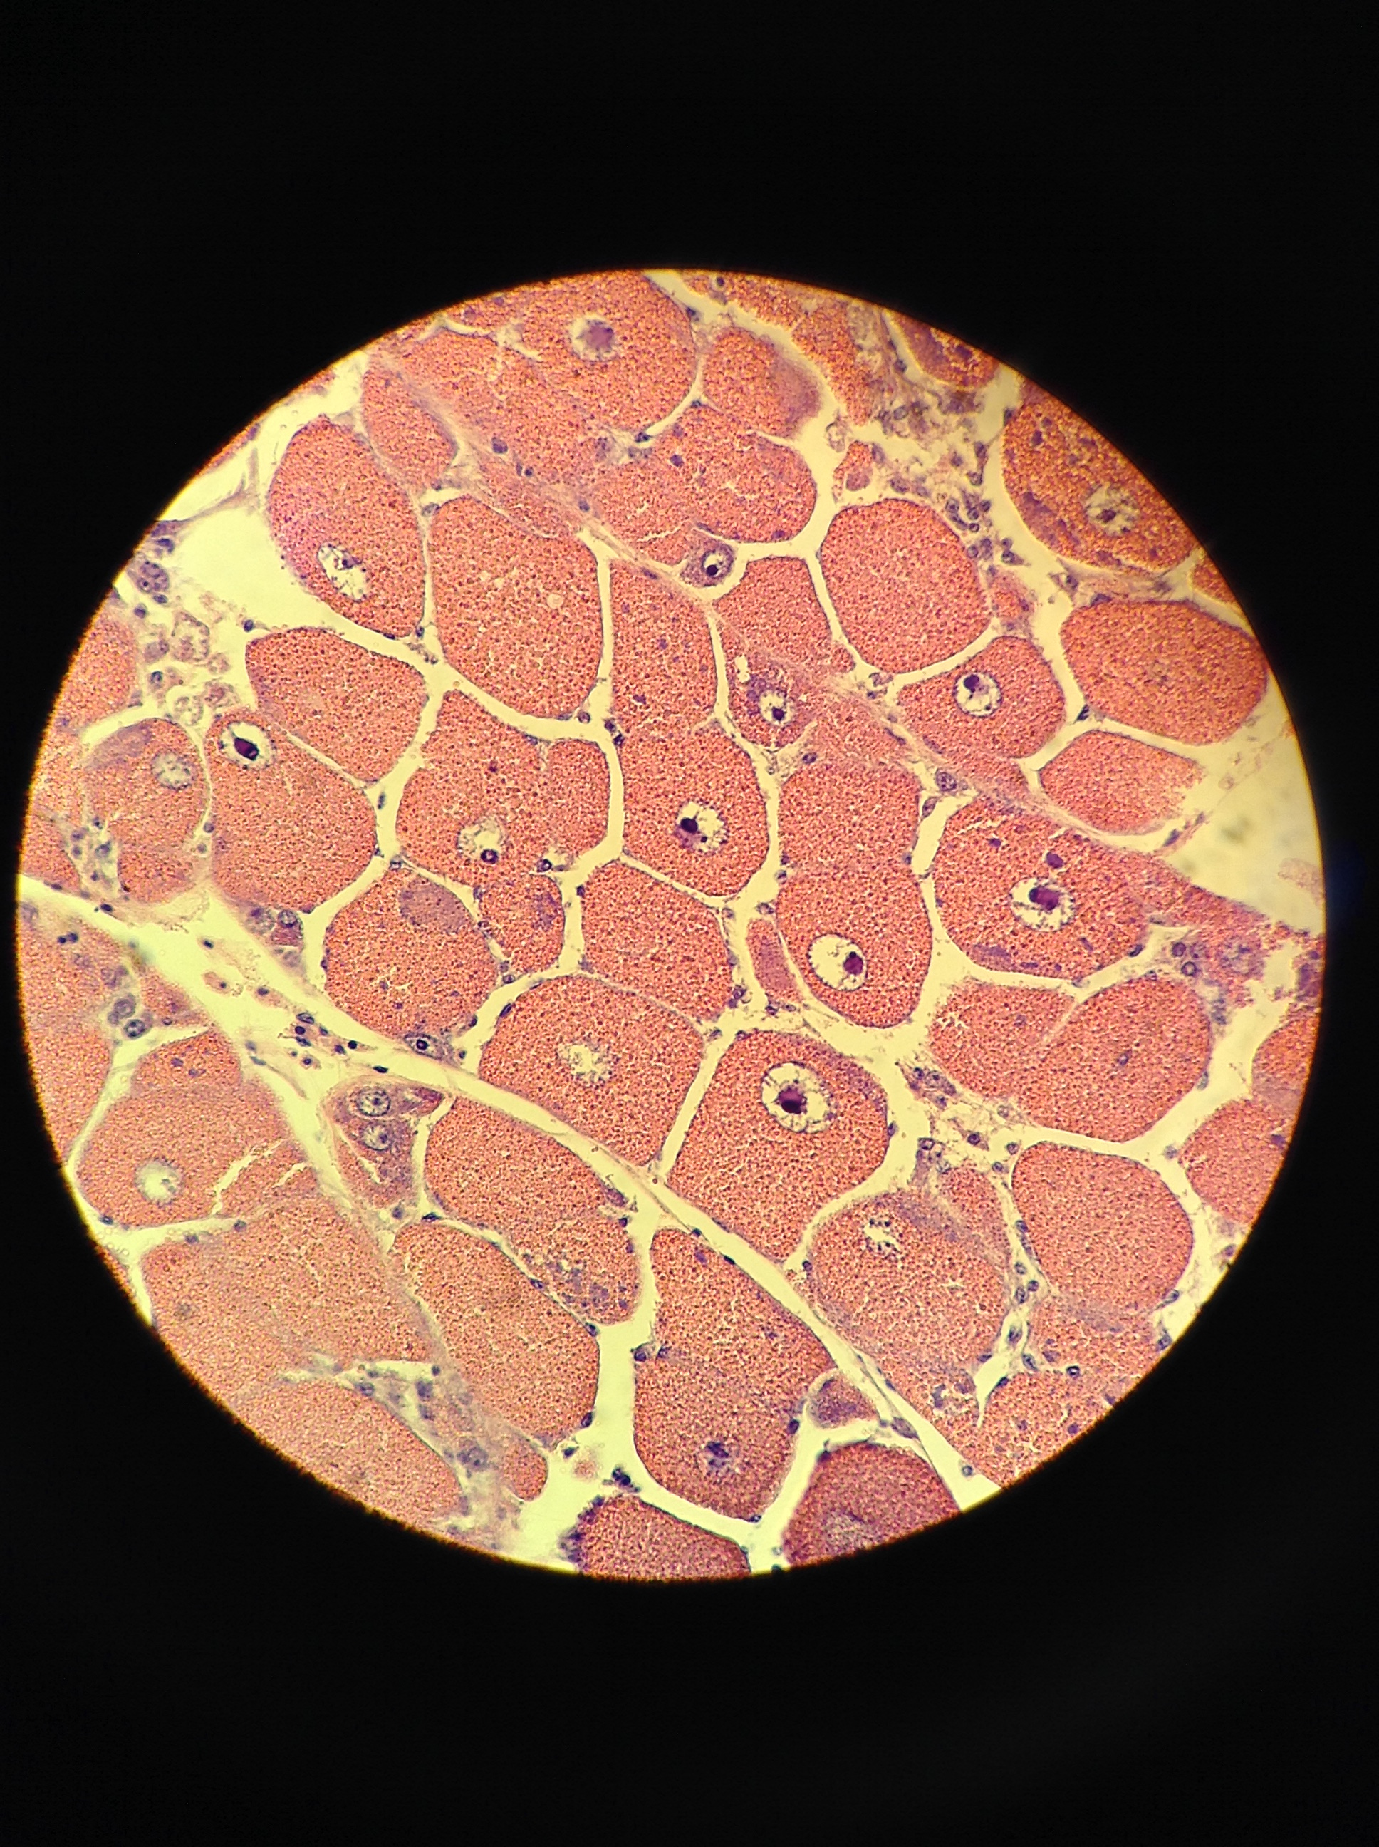
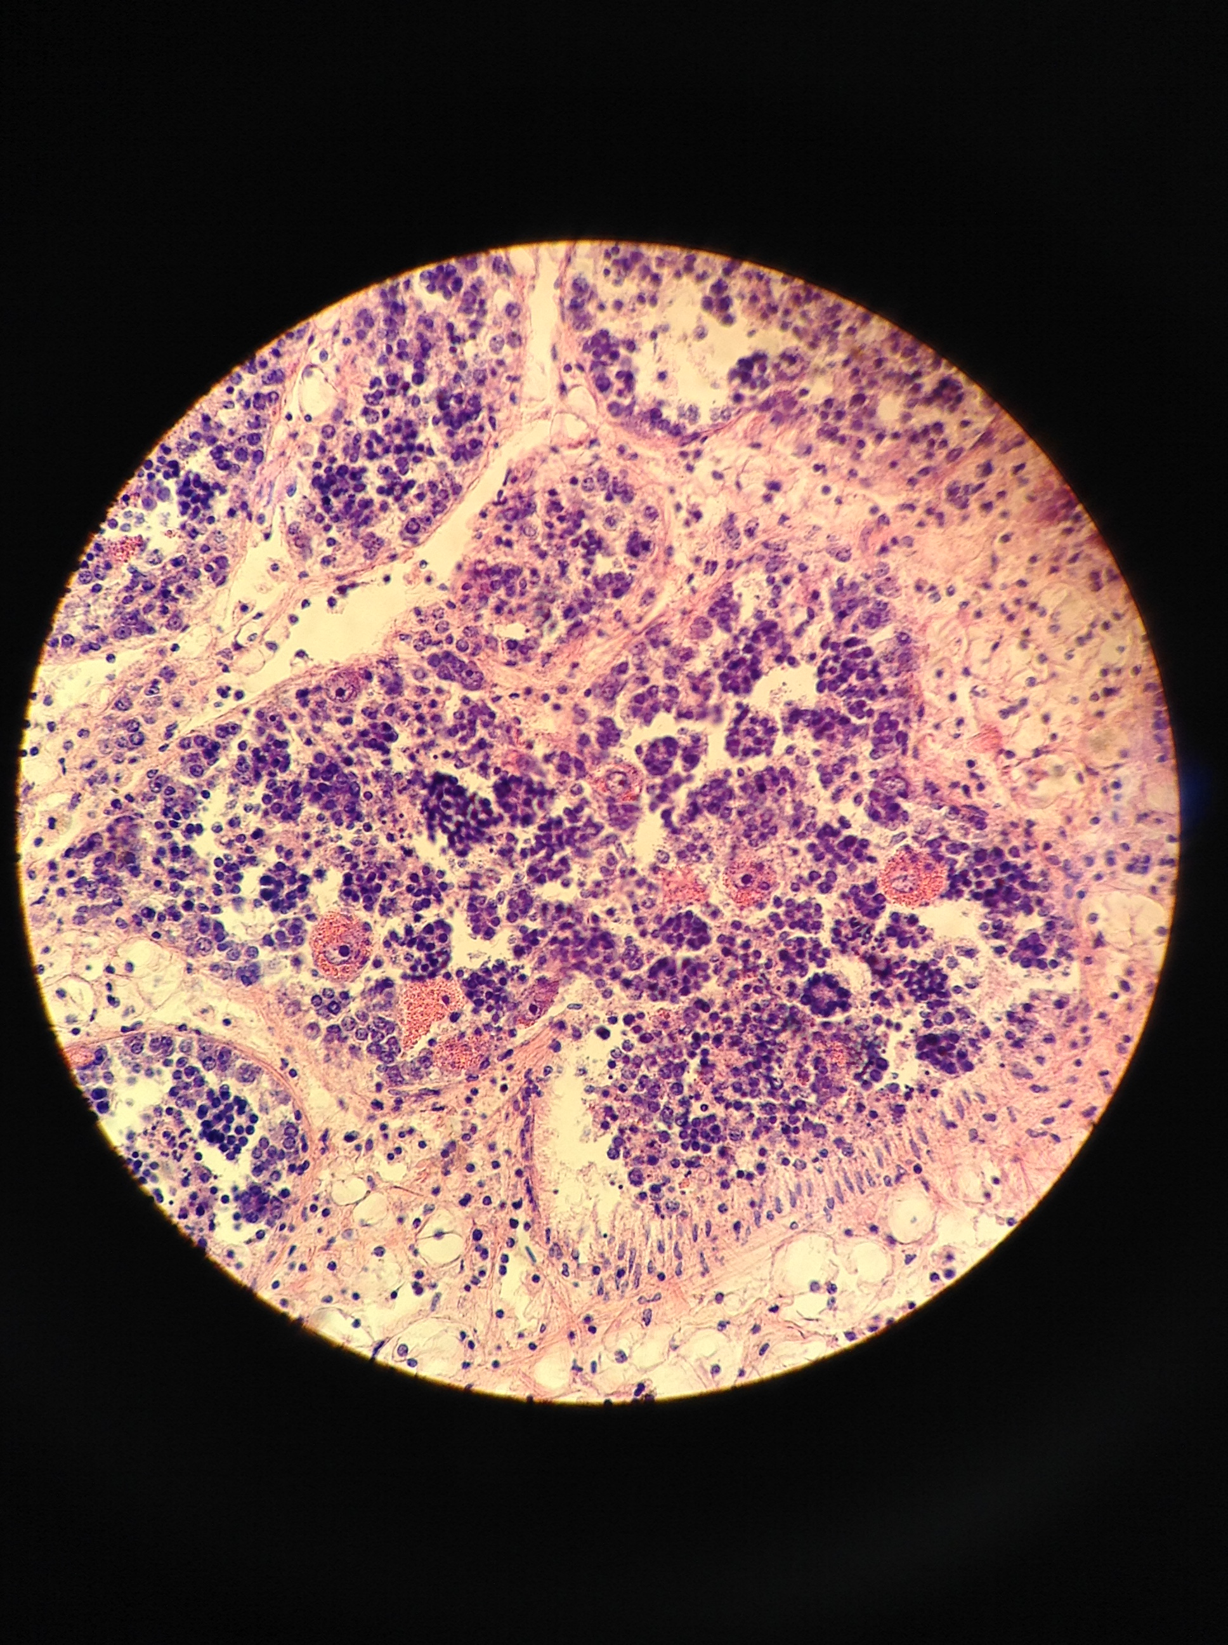
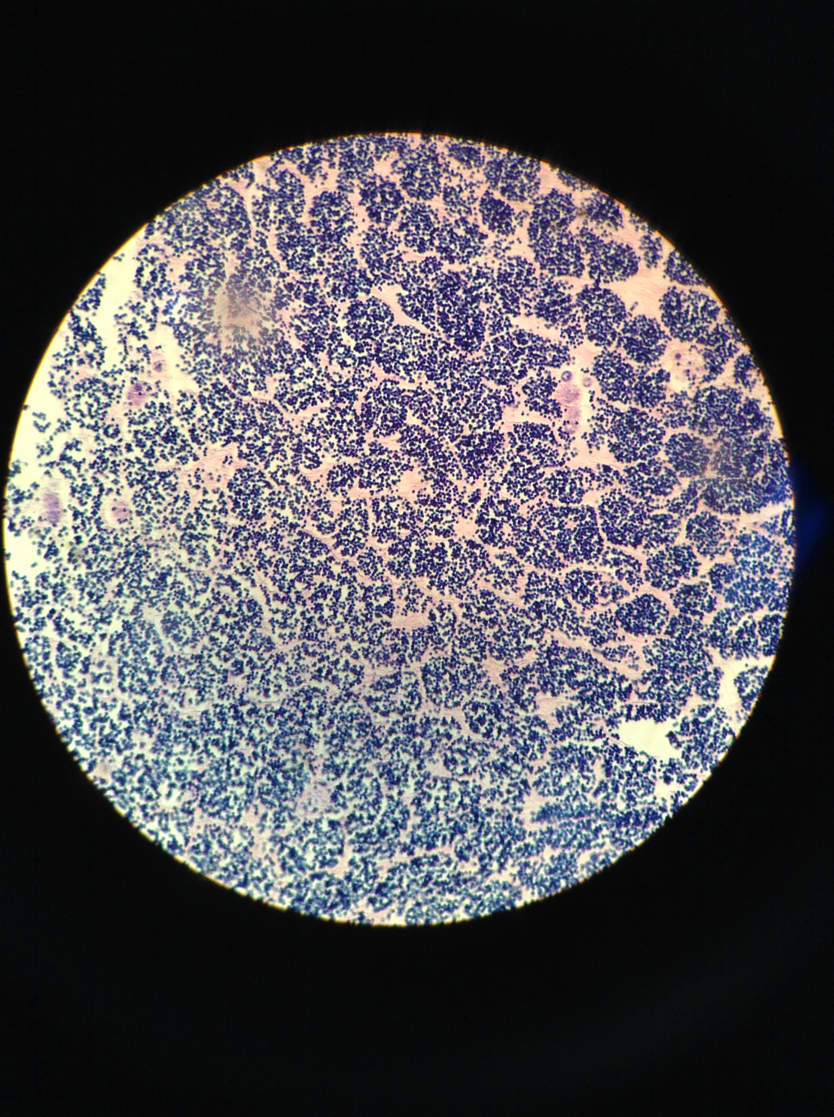
Gonad less developed in low pH
Stage 1: early female
Stage 3: ripe female
Stage 1: early male
Stage 3: ripe male

Slide 11
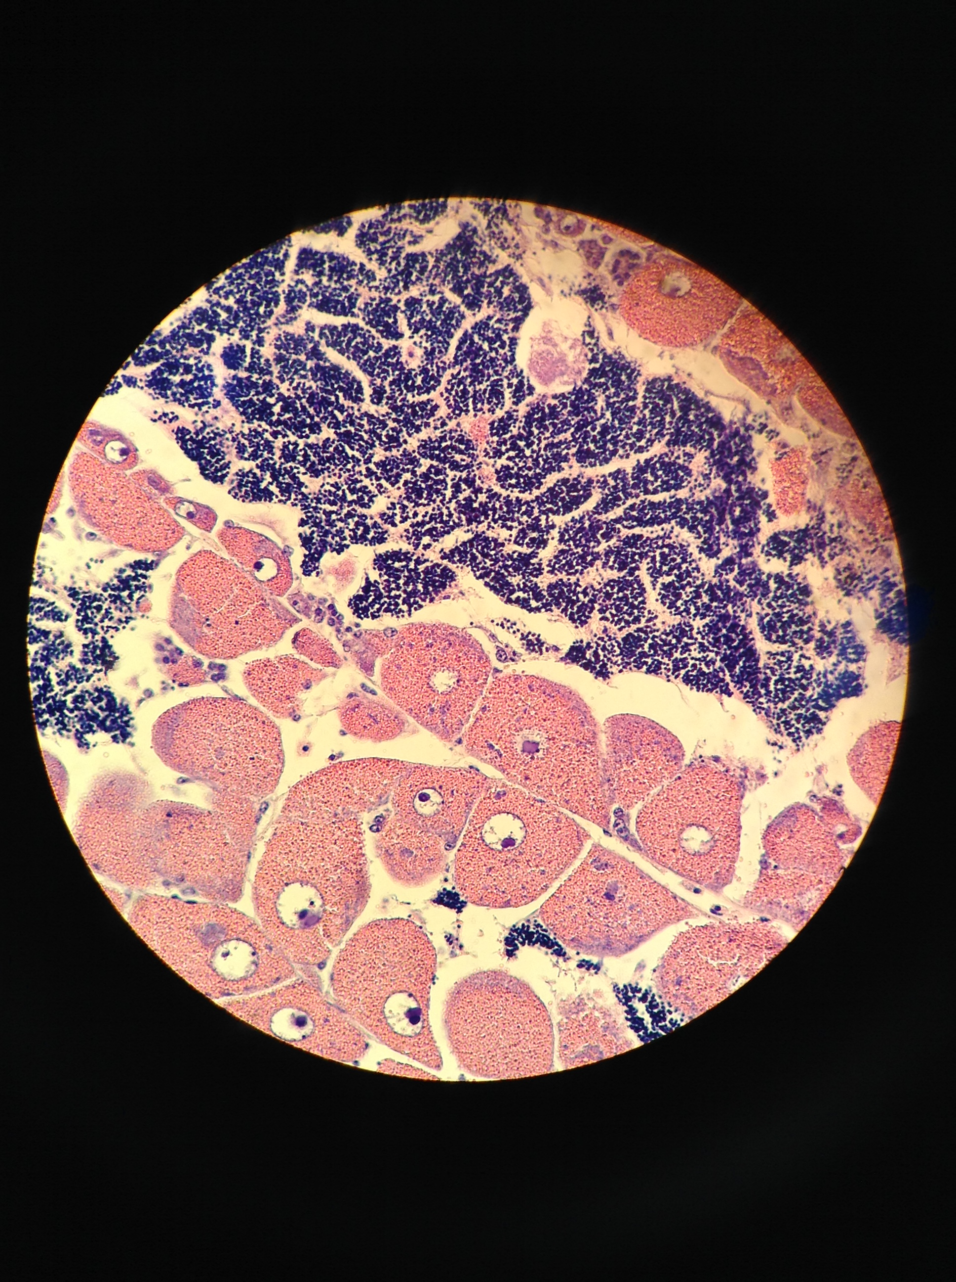
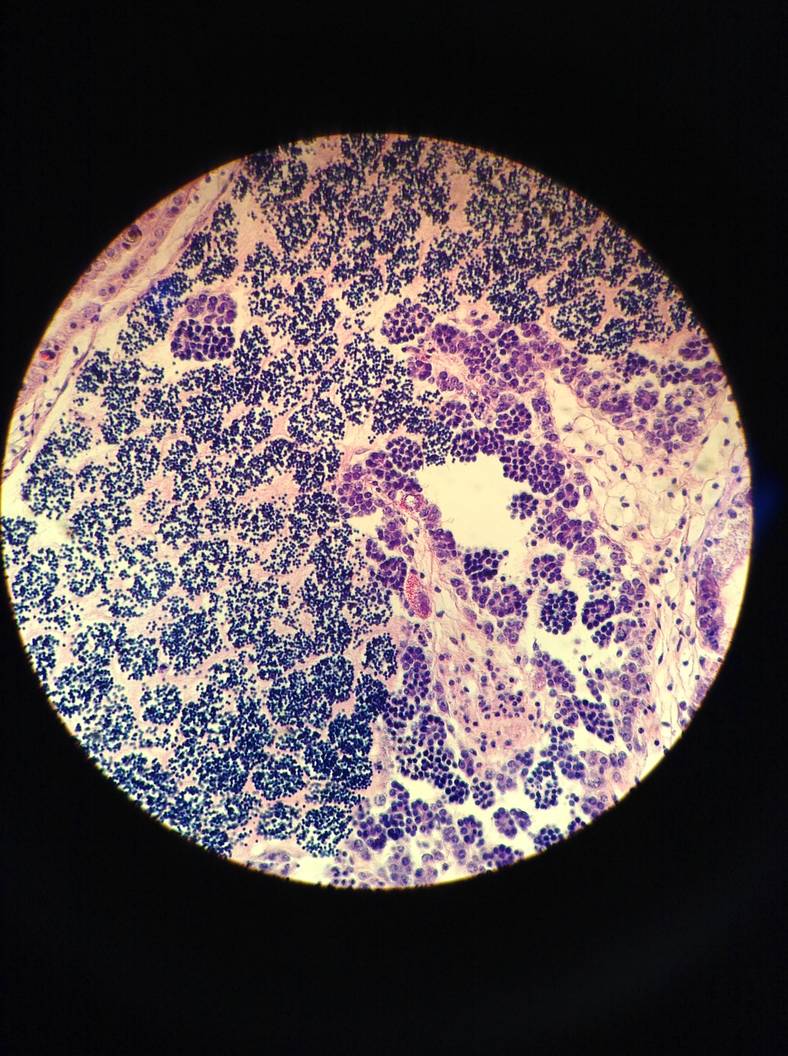
No sign. effect on gonad sex
Female
pH
Spawn & collect
Hermaphroditic
Rear
Grow
Male
pH

Slide 12
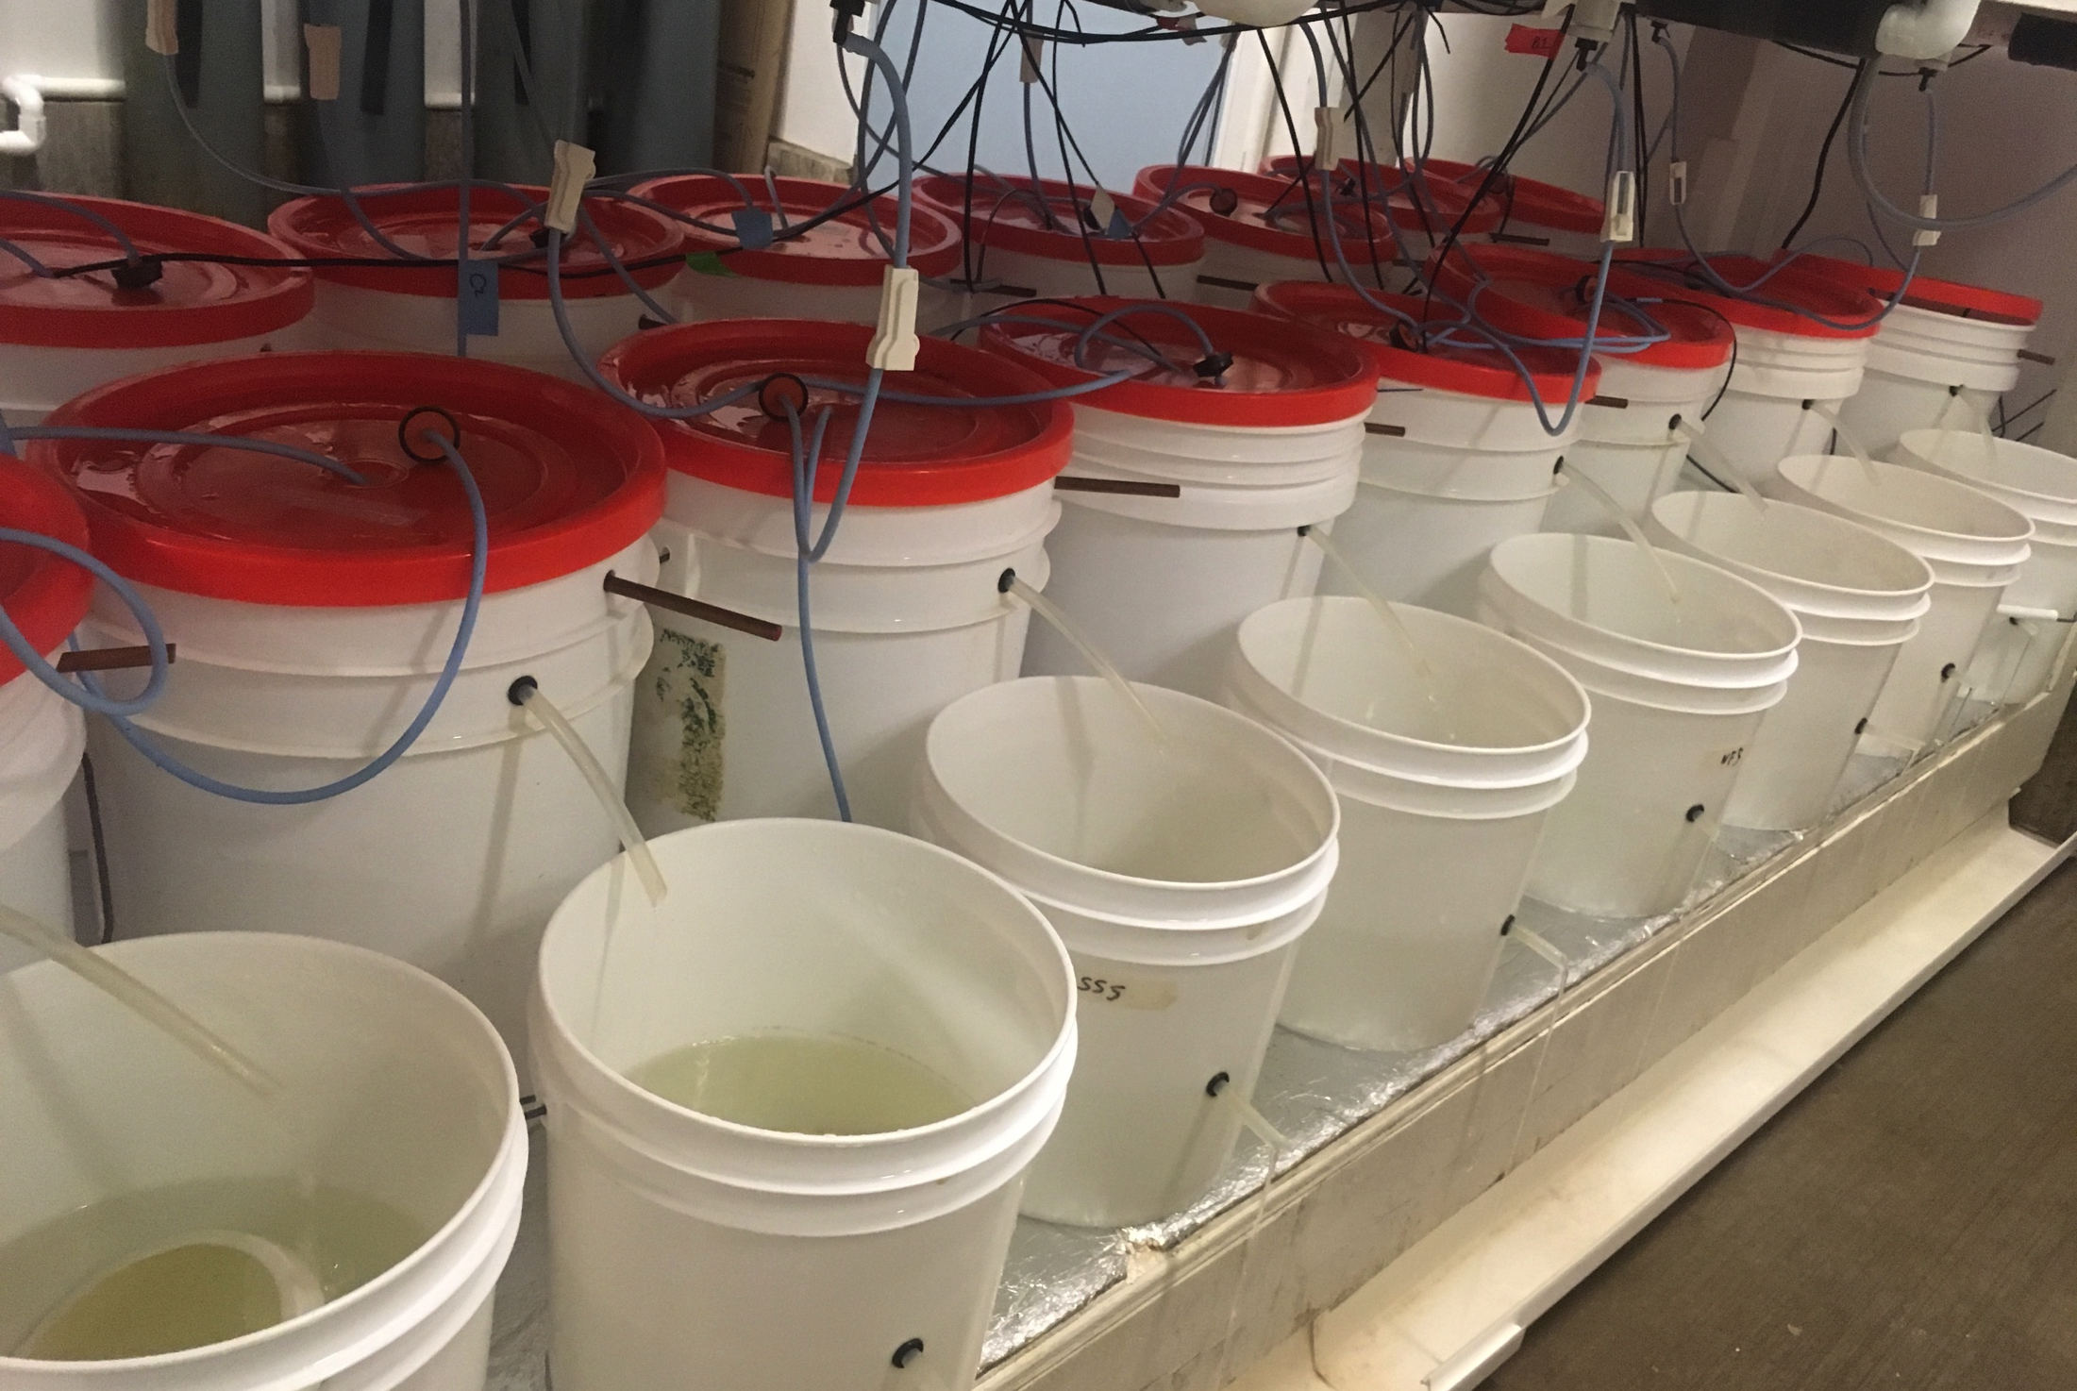
Larvae collected & counted for 7 weeks
pH
Spawn & collect
Rear
Grow
pH

Slide 13
No pH effect on larval production or timing
pH
No Difference
Spawn & collect
No Difference
Rear
Grow
pH
Notes:
- Hypothesis is that

Slide 14
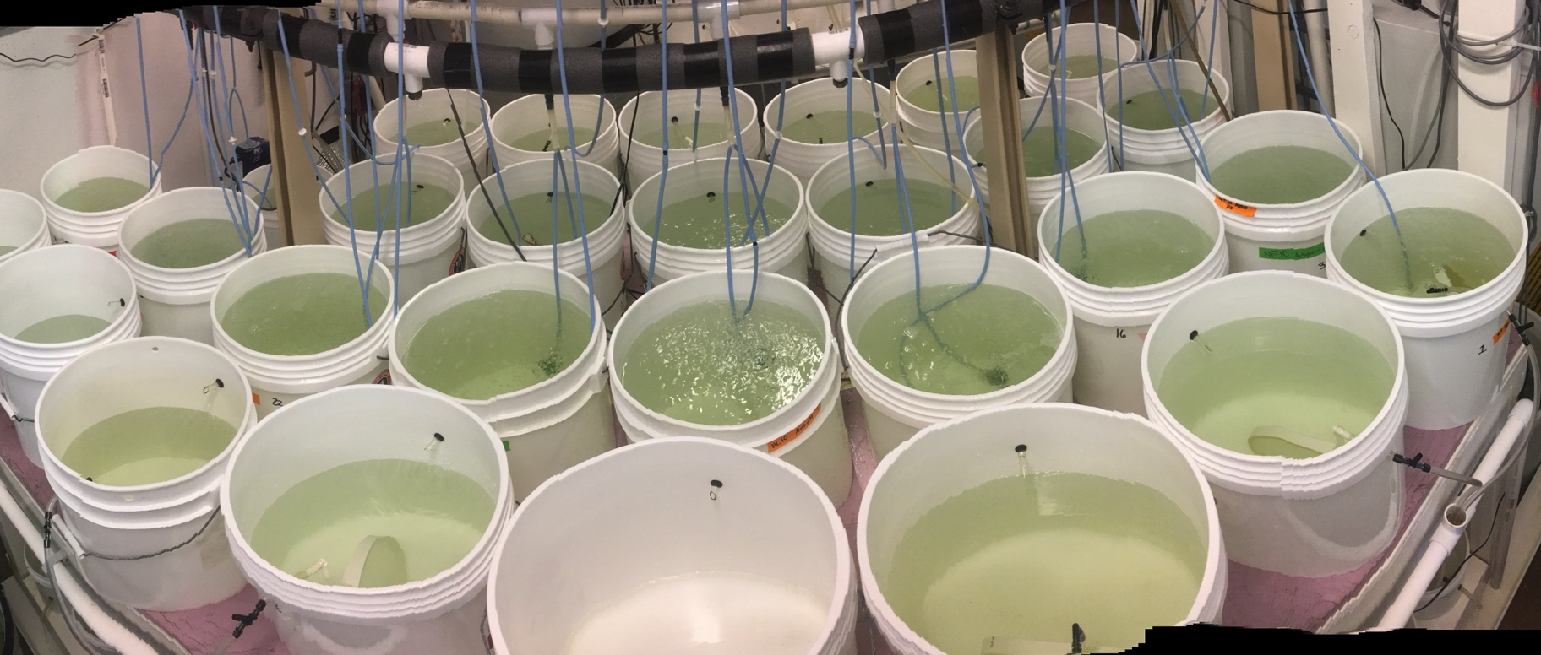
Larvae reared in treatment & spawning groups
pH
Spawn & collect
Rear
Grow
pH

Slide 15
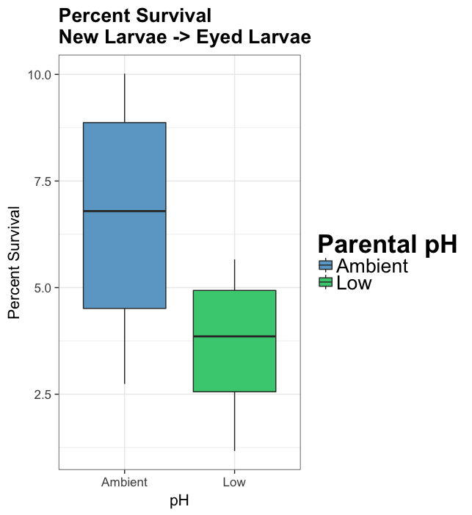


Survival trended lower from low pH parents (not significant)
pH
p=0.067
Spawn & collect
Rear
Grow
pH
Notes:
Kaplan meyer survivorship curve
Separate plots onto 2 slides, show images of larval stage

Slide 16
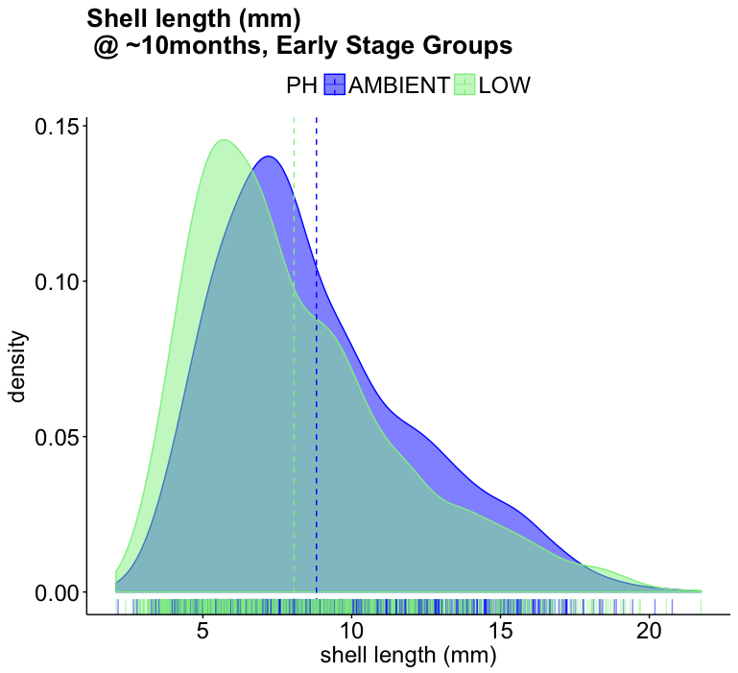
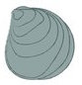
Adult exposure = ⬇ Juvenile size
pH
Spawn & collect
P<2.2e-16
Rear
Grow
pH
Notes:
Size @ 10 months sign. lower in low pH group (kruskal-wallis test; glm with gamma dist.)
6C group only, as 10C-low group very low survival and bag densities different

Slide 17
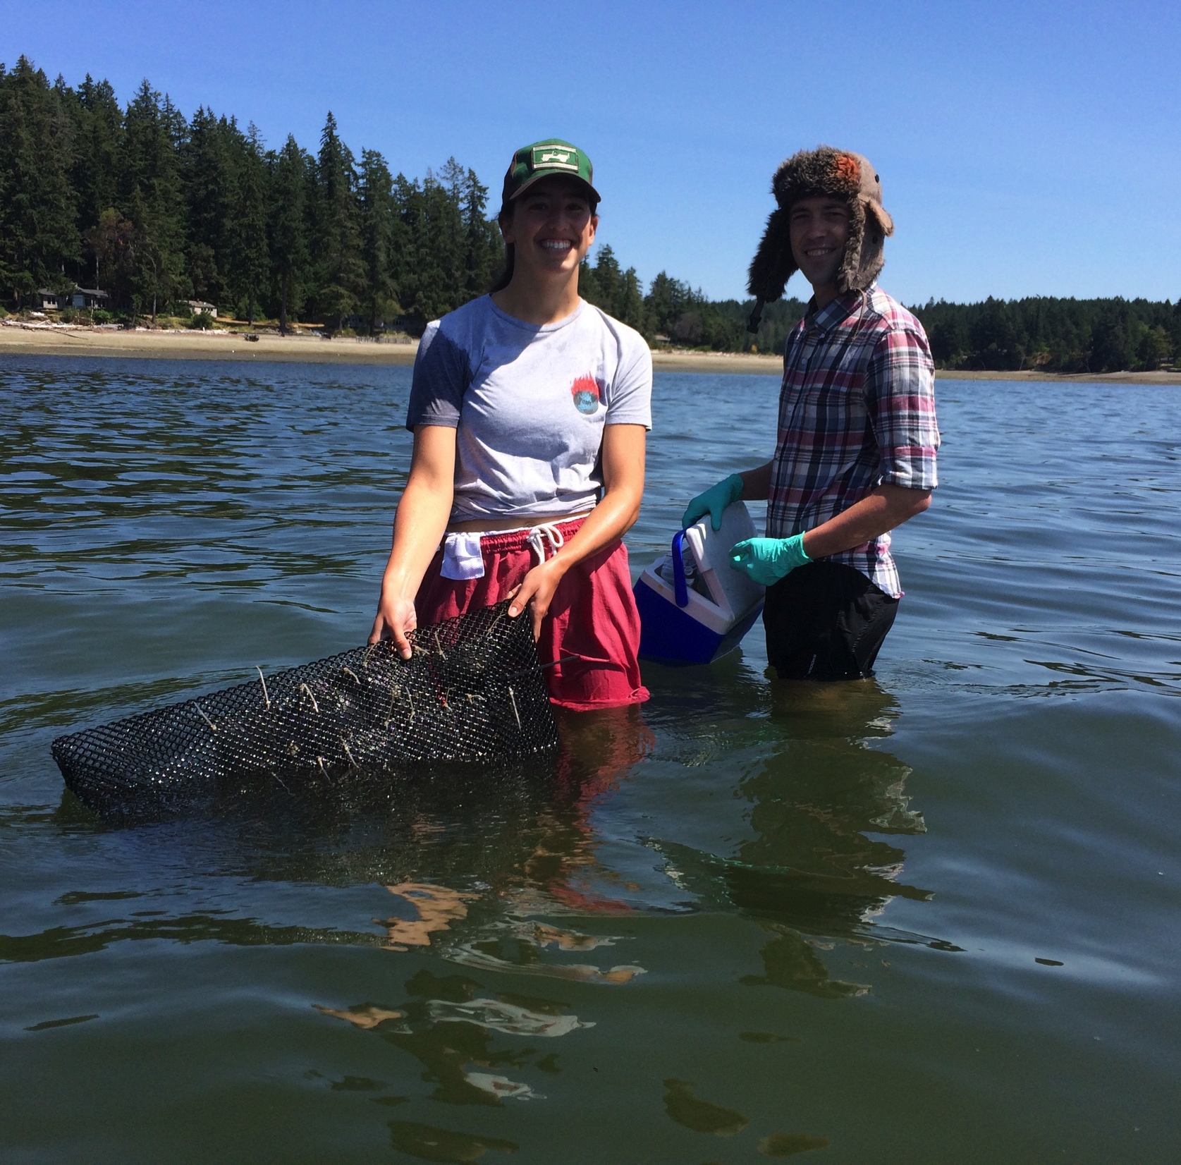
Juvenile deployment
pH
Spawn & collect
Eelgrass (7.8 pH)
Unvegetated (7.5)
4 subbasins in Puget Sound
670 oysters per parental pH history
3 months
Rear
Grow
pH
Notes:
57 pouches per pH history, # animals deployed = 5, 10, or 15 (varied by spawn group)
# BAY HABITAT DEPLOYED
# CI B 180
# FB B 160
# PG B 161
# SK B 164
# CI E 149
# FB E 180
# PG E 144
# SK E 163

Slide 18
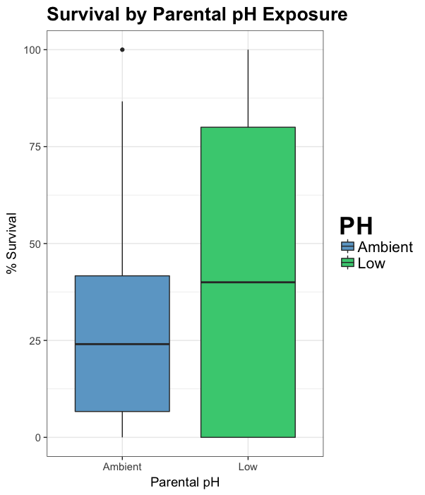
Adult low pH exposure = ⬆ offspring survival under stress*
pH
Overall mean survival between pH history:
AMB PH: 27%
LOW PH: 44%
*CAVEAT: influenced strongly by one oyster population (Fidalgo Bay)
P=8.7e-4
Spawn & collect
Rear
Grow
pH

Slide 19
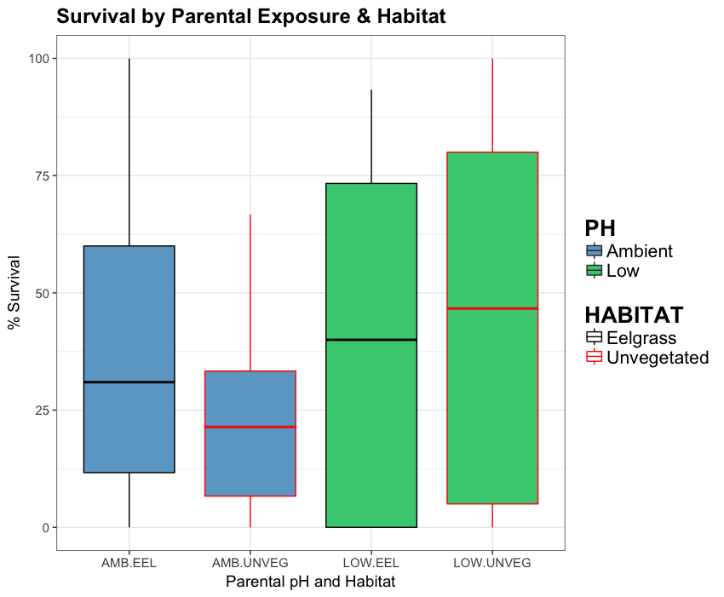
Adult low pH exposure = ⬆ offspring survival under stress
pH
Not diff.
Spawn & collect
p= 0.06
Rear
Grow
pH
Notes:
Violin plot?
Jitter plot?

Slide 20
Conclusions: parents exposed to low pH
An effect
Less ripe gonad
No effect
Reproductive output, timing
Negative carryover
Larval survival lower
Juveniles smaller (10 months)
Positive carry-over:
Survival higher during field deployment

Slide 21
Next steps
Explore mechanisms …
Gene expression in gonad, newly released larvae
Different response to acute low pH shock if parent was exposed?
Genetic and/or epigenetic?

Slide 22
thank you
Puget Sound Restoration Fund: Ryan, Stuart, Alice, Erin, Jade, Morgan, Brian, Betsy …
Helpers: Yaamini, Grace, Olivia, Megan, Rhonda, Kaitlyn, Lindsay, Duncan, Sam, Hollie, Steven, Steven’s kids, Brent, Mom & Ian
WA DNR: Micah, Emily
Committee: Steven, Rick, Jackie

